Slide 1
CYCLISTIC BIKE SHARE ANALYSIS
Project Done by Ajith Kumar Ganesan

Slide 2
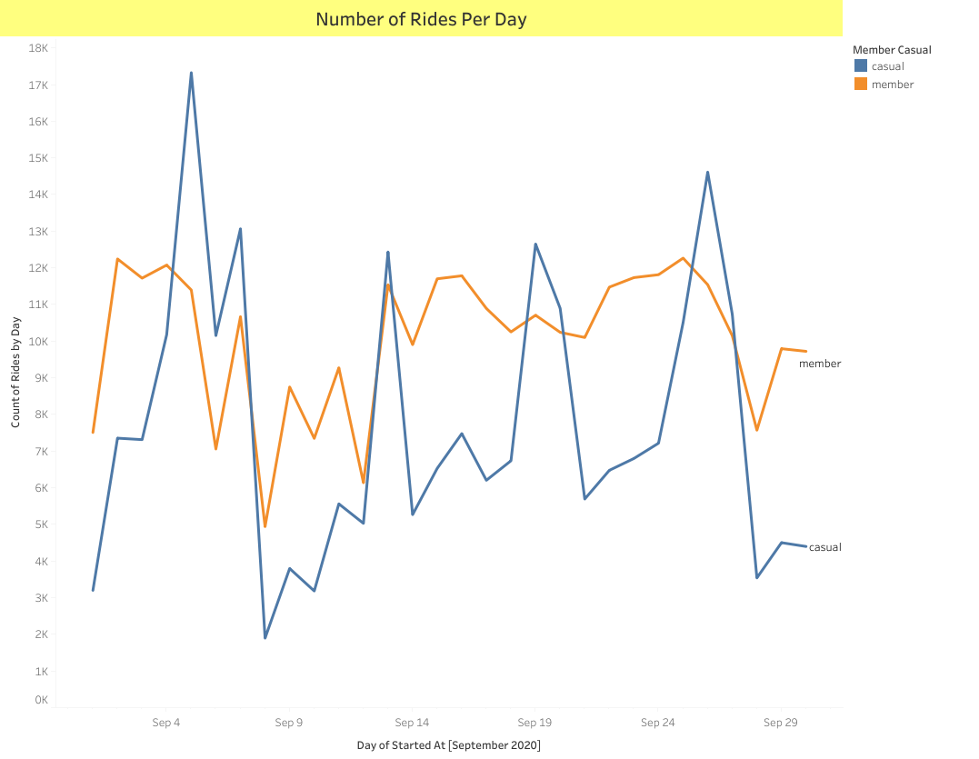

Slide 3
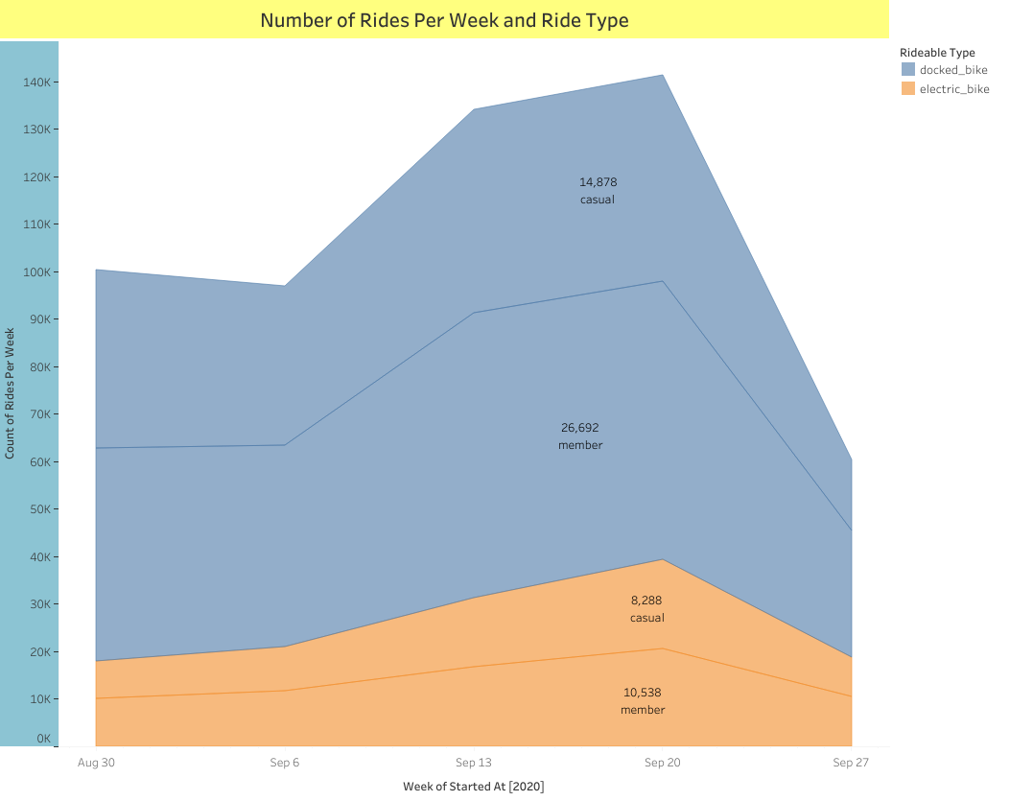

Slide 4
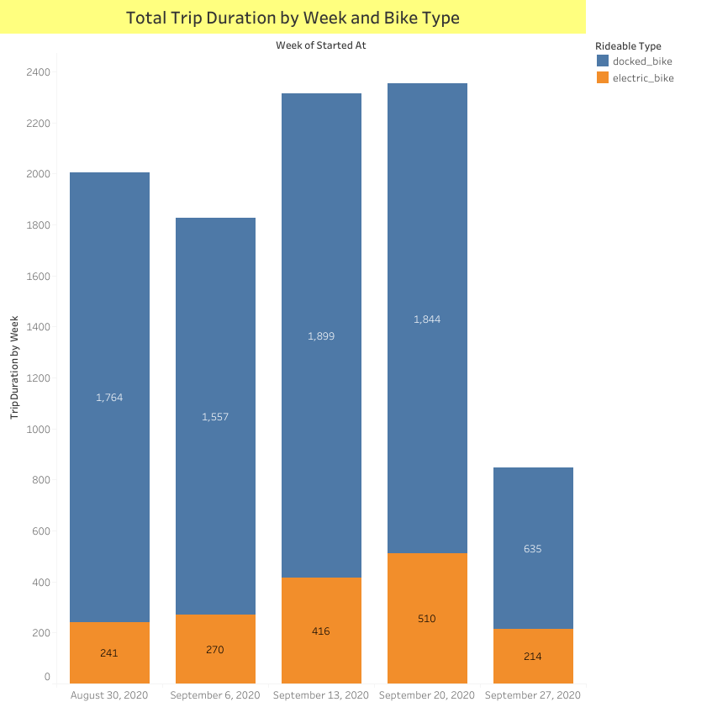

Slide 5
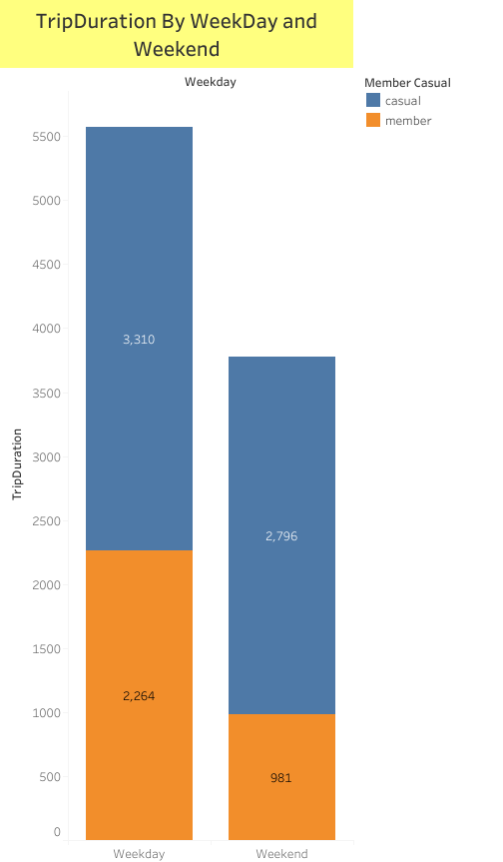

Slide 6
